Slide 1
World Bank

Slide 2
World Bank
The World Bank is a global organization that provides funding and financial assistance to developing countries. The prime purpose of this bank is to provide low-interest loans, address global issues and reduce poverty.

Slide 3
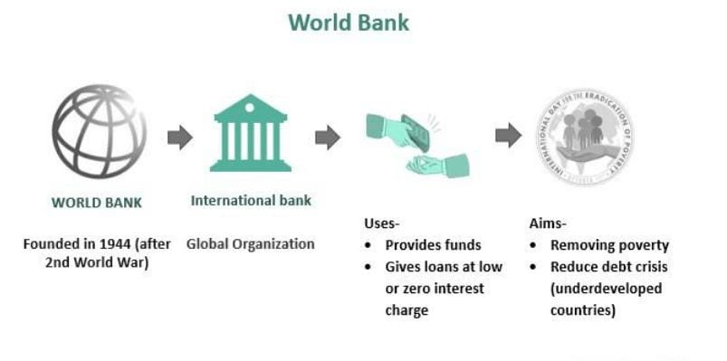

Slide 4
Founded after World War II, this group has been around for more than 50 years. It acts as a funding system for underdeveloped countries. It collaborates (works) with partners to help get rid of poverty. Besides, it also conducts research and provides a database on market indicators. However, this bank often creates a biased situation between the rich and emerging nations.

Slide 5
How Does The World Bank Work?
The World Bank Group provides low-charged interest loans to poverty-driven countries. It aims to enhance the overall economic development of all nations and increase their gross domestic product (GDP). Primarily they target or observe underdeveloped nations. Originally founded at the Bretton Woods Conference in 1944, it officially began its operations in 1946. The blue outlined globe is considered the world bank logo. World Bank headquarters are in Washington, D.C.

Slide 6
In total, 189 member nations represent themselves on the Board of Governors. These members draft the policies of the bank during the board meetings. Despite this, the meetings occur only once a year. However, specific criteria exist for becoming a member. A country must join the IMF (International Monetary Fund) before joining the World Bank. Also, they have a right to elect 25 executive directors working in the World bank headquarters. For electing one executive director, five votes are necessary. These directors meet twice a week to execute the operations of the bank.

